Slide 1
JPEG 2000 : Still Image Compression Standard
Ifiok J. Umoh

Slide 2
Content
Introduction
JPEG 2000 Technology
  Preprocessing
    Image Tiling
    DC level shifting
    Component Transformation
  Core Processing
    Wavelet Transform
    Quantization
    Entropy Coding
Conclusion

Slide 3



Introduction

Slide 4
Introduction
Joint Photographic Expert Group (JPEG) is an International Organization of Standards (ISO) and International Telecommunications Union (ITU) standard for compression of grayscale and color still images.
JPEG initially was based on a simple, efficient 8-by-8 DCT compression algorithm that uses Huffman coding, operated in sequential mode, and was restricted to 8-bit/pixel input.

Slide 5
Introduction
Why JPEG2000 ?
The need to cater for new applications such as high-resolution imagery, digital library, high fidelity color imaging, multimedia and internet applications, wireless, medical imaging, etc.
Mitigate the short comings of JPEG such as
  Distortion and artifacts
  Ineffective handling of high-quality images
  Poor compression for images
  Lack of effective color-space support
  Lack of resolution scaling
Provide and open system approach to image applications

Slide 6
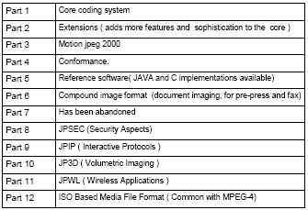
JPEG 2000 Standard

Slide 7
JPEG 2000 Technology

Slide 8
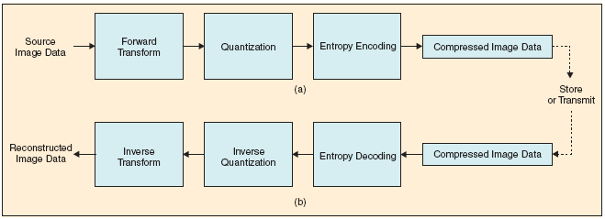
JPEG 2000 Encoder & Decoder

Slide 9
Preprocessing
Image Tiling
The partitioning of the original (source) image into rectangular non-overlapping blocks (tiles) which are compressed independently.
Advantage:
  Reduce memory requirements
  Decode specific parts of the image instead of the whole image
Recommendations:
  Components with different sub-sampling factors are tiled with respect to a high resolution grid.
  Do not tile small images (<= 512 by 512)

Slide 10
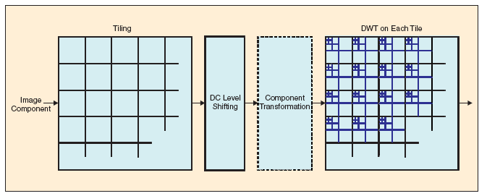
Preprocessing

Slide 11
Preprocessing
DC Level Shifting
JPEG 2000 expects its input sample data to have a nominal dynamic range that is approximately centered about zero (0 – 255 -> -128 – 128)
If the sample values are unsigned the nominal dynamic range of the samples is adjusted by subtracting the quantity 2^{(p-1)} from each unsigned image tile component. p = component’s precision. (converts an unsigned representation to a two’s complement representation or vice versa)
Performed prior to color transformation

Slide 12
Preprocessing
Component Transformation
Advantage:
  Color de-correlation for efficient compression
  Color spacing with respect to the human visual system for quantization
  Ability of having lossless compression
Irreversible component transformation (ICT) can be used for lossy coding only with the 9/7 irreversible wavelet transform
Reversible component transformation (RCT) can be used for lossless or lossy coding only with the 5/3 reversible wavelet transform
Convert the uncompressed RGB color image to the YCbCr color space except when the RGB image primarily consists of one color component

Slide 13
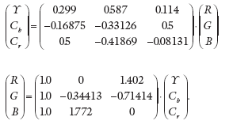
Preprocessing
Forward and Inverse ICT

Slide 14
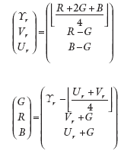
Preprocessing
Forward and Inverse RCT

Slide 15
Core Processing
Wavelet Transform
Analysis of the tile components into different decomposition levels that describe the horizontal and vertical spatial frequency characteristics of the original tile component.
Problem with traditional wavelet transform:
  filtering to be performed in both vertical and horizontal directions. While access in one direction is easy, access in the other will require whole image to be buffered
  Difficult for implementation on PDA or other hand-held devices with limited amount of main memory

Slide 16
Core Processing
Wavelet Transform
Convolution based filter mode:
  Performing a series of dot products between the two filter masks and the extended 1-D signal
Lift based filter mode:
  A sequence of simple filtering operations for which alternately odd sample values of the signal are updated with weighted sum of even sample values, and vise versa.

Slide 17
Core Processing
Wavelet Transform
Floating point 9/7 wavelet filter for lossy compression
  Best performance at low bit rate
  High implementation complexity
Integer 5/3 wavelet filter for lossless coding
  Integer arithmetic
  Low implementation complexity
The transform is performed by filtering each row and column with a high pass and low pass filter, followed by down-sampling by 2 (to keep the sample rate)

Slide 18
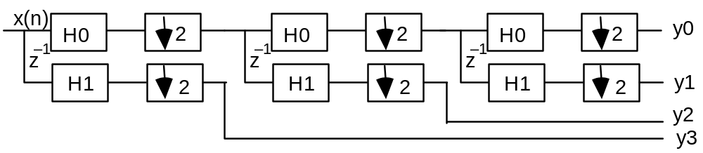
Core Processing
1D Discrete Wavelet Transform
HO: low pass digital filter,
H1: high pass digital filter.
Z⁻¹: delay, ↓2: down-sample by 2
Recursive application of
wavelet transform in spatial
domain corresponds to dyadic partition of data in the frequency domain.
y0
y1
y2
y3
π /8
π /4
π /2
π

Slide 19
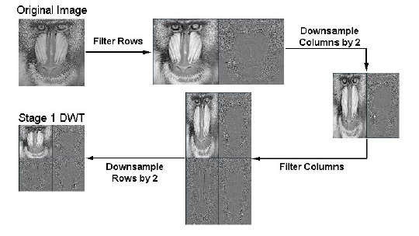
Core Processing
1D Discrete Wavelet Transform Example

Slide 20
Core Processing
2D separate DWT
L
H
LL
LH
Image in
spatial
domain
HL
HH
1D DWT applied alternatively to vertical and horizontal direction line by line.
The LL band is recursively decomposed, first vertically, and then horizontally.
This is Mallat method. Other methods have also been proposed.
LH
LH
HL
HH
HL
HH

Slide 21




Core Processing
Lossless 1D DWT
Forward transform
Reverse transform
I₀−1 ≤ 2n+1 < i₁ −1; I₀ ≤ 2n < i₁ ;
I₀−1 ≤ 2n < i₁ −1; I₀ ≤ 2n+1 < i₁ ;
X_{ext}(), Y_{ext}(): symmetrically, cyclic extended signals.
Reversible Integer DWT
DWT coefficients are integers without any truncation error provided image component pixel values are also integer-valued.
Transform is exactly reversible.
Non-causal filter.

Slide 22
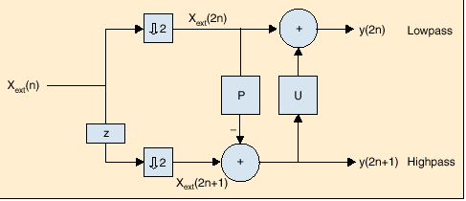
Core Processing
5/3 Wavelet Transform
Were P and U represent prediction and update

Slide 23
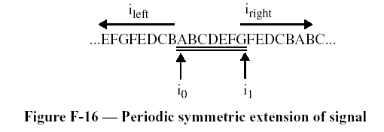
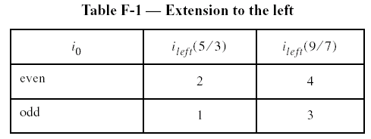
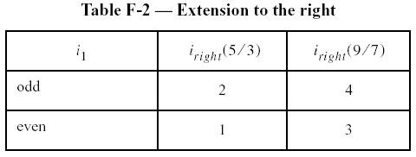
Core Processing
Wavelet Transform: symmetric extension

Slide 24
Core Processing
Quantization
The purpose of quantization is to approximate each transformed coefficient with few prototypical values so that fewer bits will be needed to encode the transformed coefficients.
Quantization is used only in lossy compression.
Quantization is a grouping or clustering process.
Scalar vs. vector quantization.

Slide 25
Core Processing
Quantization
Progressive quantization
  Start with few prototypes
  Incrementally improve accuracy by adding new quantization levels (prototypes).
  When all bits are encoded, becomes lossless quantization.
Bit plane coding
  Progressive scalar quantizer
  Binary representation
  Start from MSB toward LSB

Slide 26
Core Processing
Entropy Coding
Uses an arithmetic coding system that compresses binary symbols relative to an adaptive probability model associated with each of 18 different coding contexts.
Accomplished using the MQ coding algorithm
MQ coding algorithm also manages the adaptation of the conditional probability modes
Algorithm is compatible to arithmetic coding used in JBIG2 compression standard

Slide 27
Core Processing
MQ Arithmetic coding
MPS: more probable symbol with probability Pe
LPS: less probable symbol with probability Qe
If M is encoded, current interval is the Pe part, else, it is the Qe part (bottom). The length is kept in variable A.
Code string C points to the base of the current interval.
M M L M
P_{e}
Q_{e}

Slide 28
Core Processing
MQ Arithmetic Encoding of MMLM
if MPS is encoded
C ← C+Qe
A ← A−Qe
else(LPS is encoded)
A ← Qe
end
if A < 0.75
Renormalize A and C;
Update Qe;
Interval A is kept between 0.75 and 1.5. Binary 0x8000 is used to represent 0.75 to make comparison easy.
Each time A is doubled, so does C. The higher order byte of C register is overflowed to an external buffer (compressed code stream).
A(0)
Qe
Qe
Qe
C(the pointer
of code string)
Qe
0
Context:
M
M
L
M

Slide 29
Core Processing
MQ Arithmetic decoding of MMLM
If C>=Qe( MPS is decoded)
C <- C-Qe
A <- A-Qe
else(LPS is decoded)
A <- Qe
end
if A<0.75
Renormalize A and C;
Update Qe;
A(the current interval)
C(the pointer
of code string)
Qe
Qe
Qe
Qe
0
Context:
M
M
L
M

Slide 30
Core Processing
JPEG 2000 Arithmetic coding
Uncompressed
data
compressed
data
Context model
Arithmetic decoder
Context (CX)
Decision (D)
MPS
Qe
Probability estimator
Probability estimator
MPS
Qe
Context (CX)
Decision (D)
Arithmetic encoder
Context model
compressed
data
Uncompressed
data

Slide 31
Conclusion

Slide 32
Conclusion
JPEG2000 is an emerging image coding standard for the next generation of digital imaging.
No IPR (intellectual property right) on part I of the standard (free licensing)
More complex than JPEG but designed with hardware implementation in mind.

